Slide 1
LLM-driven Unit Testing for Autonomous Driving Software
A study on Autoware with LLM-driven unit testing · Wang, Xie, Huang, Wang, Chen, Ma
University of Alberta · The University of Tokyo · FSE '25
Shourrya Guha,
MASc, Computer Engineering

Slide 2
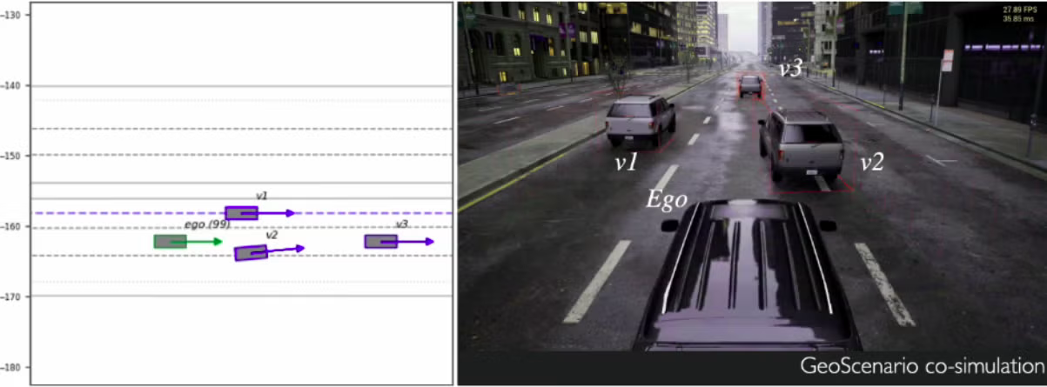
Why This Matters?
Autonomous vehicles are safety-critical — but most AD research tests behavior, not code
S
Existing AD testing = scenario testing
Simulate driving and collision scenarios, check whether the car makes safe overall decisions. Focus is on system-level behavior, not the source code underneath.
U
Unit testing = untouched territory
Function-level tests catch bugs before they ever reach a scenario. This paper is the first study of unit testing specifically for AD source code.
Scenario testing example with CARLA

Slide 3
The Software Used and The Problem
The Problem
Human Devs are not writing enough tests
Existing test cases for Autoware have limited coverage
Most modules in Autoware software are untested
Autoware: 200K+
lines of C++ code across 10 ADS modules
Built by TIER IV · runs on ROS 2 for messaging between components

Slide 4
Background: Unit testing in C++
What Is Unit Testing?
Why C++ Makes It Harder
A unit test checks a single function or small component in isolation — separate from the rest of the program — to confirm it behaves correctly given specific inputs.
No built-in test runner
Unlike Python (unittest/pytest) or Java (JUnit), C++ has no standard framework baked into the language
Compilation is part of the problem
Typical workflow
Tests must correctly resolve headers, namespaces, and linked libraries just to build
Write a small test file exercising one function
Compile & link it against the library under test
Assert the actual output matches the expected result
Run automatically as part of the build (e.g. via CMake/CTest)
Isolating functions is hard
Isolating a function from the rest of a large codebase often takes real engineering effort

Slide 5
Three Research Questions
RQ1
RQ2
RQ3
How good are Autoware's existing
human-written tests?
How well do off-the-shelf LLMs
generate unit tests for it?
Can a better LLM pipeline fix
the problems we find?

Slide 6
RQ1 - The Numbers are Rough
8/10
36.4%
16.0%
modules have
very low test coverage
overall function
coverage
function coverage in
planning module
Four recurring reasons code goes untested:
Whole code files skipped
Certain branches of if-else conditions untriggered
Auxiliary functions skipped
Exception handling untested

Slide 7
RQ2 – Can Simple Prompting of LLMs Generate the Missing Tests?
Benchmark: 1,126 functions across 8 modules · Covered (390) vs. Uncovered (812)
1
Prompt LLM with the function + whole containing file
Two models compared
GPT-4o-mini vs. GPT-4o
2
Insert generated test into the package's CMake build
Three metrics
3
Build & run with colcon
Build success — does it even compile?
Run success — does it execute without crashing?
Line coverage — % of code the test actually exercises
4
Measure coverage with lcov

Slide 8
RQ2 – Naive LLM Prompting Falls Short
<10%
line coverage in 5 of 8 modules
(GPT-4o-mini, basic setting)
For comparison
These build/pass rates are far below what LLMs typically achieve generating tests for Java or Python repos. Real, industry level, dependency-heavy C++code breaks the usual pattern.

Slide 9
RQ2 – Why does naive LLM Prompting Fail?
The LLM doesn't actually know the codebase's structure
#1 failure: Symbol(Syntax) errors (~30%)
The LLM invokes functions/members that don't exist, or misuses real ones — classic hallucination, here applied to an unfamiliar C++ codebase.
#2 Even when it builds: assertion errors dominate runtime failures
The model can often guess valid C++ syntax, but still doesn't know what the function is supposed to return — it guesses wrong expected behavior.

Slide 10
RQ3 – AwTest-LLM: Giving the LLM Context
The LLM doesn't actually know the codebase's structure
1
2
3
4
5
AST Parsing
Call-Graph Extraction
Doc Generation
CMake Parsing
Test Generation
→
→
→
→
Parse every C++ file (tree-sitter) to extract namespace, headers, class metadata
Find functions that call the target functions being tested — use as few-shot examples for LLM
LLM writes docs about functionality, args, return values etc. for complex functions
Extract external Autoware/ROS package dependencies
Assemble a rich prompt: file + namespace + docs + deps + examples

Slide 11
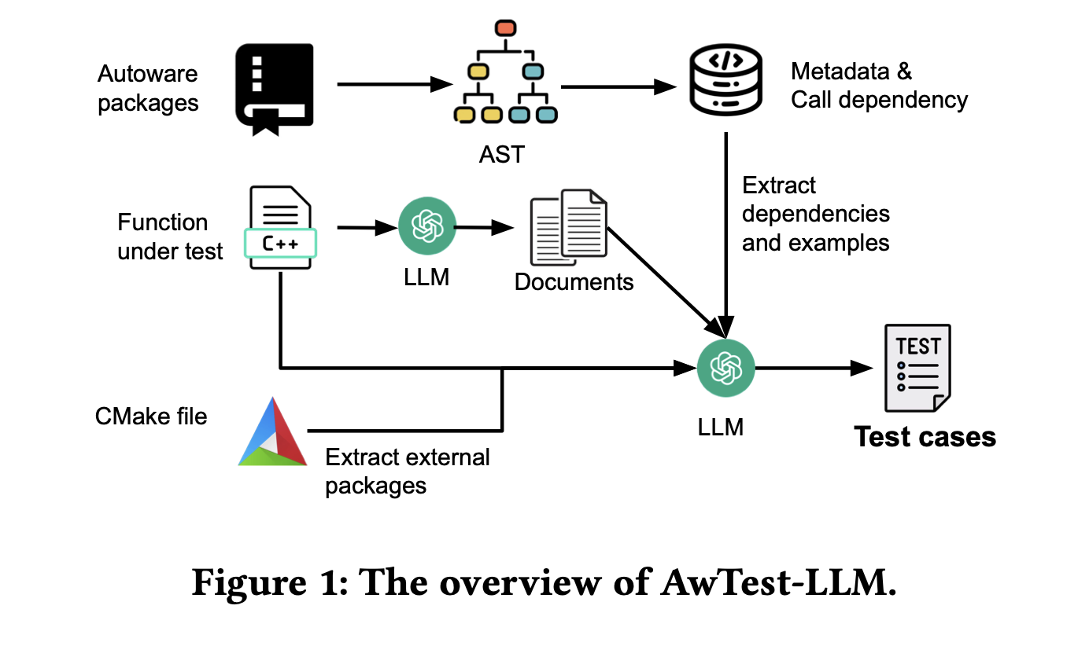
RQ3 – Graphical Representation of AwTest-LLM

Slide 12
RQ3 – Improvements with AwTest-LLM
+11.6%
overall line coverage gain for GPT-4o vs. the basic prompt
The catch
Context fixes compilation, not correctness of expected values — assertion accuracy barely improves. And on never-tested ("uncovered") functions, coverage stays under 10% for most modules.

Slide 13
RQ3 – Takeaways
Human-written unit tests in industrial AD software are surprisingly thin — most packages, and most functions within tested packages, are left uncovered.
1
Naive LLM test generation struggles badly on real industrial C++ code.
2
Codebase-aware context (dependencies, call graphs, docs) meaningfully helps build/run success, but doesn't fix assertion correctness.
3

Slide 14
Discussion Q1: Would an agentic approach be better than this static pipeline?
AwTest-LLM is static: parse → gather context → prompt → generate → check build. It never debugs itself. An agent would compile, read errors, and iteratively fix its own code.
A
Agentic approach is better
B
Not necessarily
Human devs lean on compiler feedback too
A sandboxed agent could run colcon, read ROS 2 error logs, adjust imports
Could resolve the exact syntax errors & missing headers that sink static prompts
C++ errors (templates, deep dependencies) are cryptic even for experienced developers
Without real architectural understanding, the agent may get into an infinite loop
Risk: forces code to "compile" while quietly breaking the test's actual logic

Slide 15
Discussion Q2: Are we saving time, or just shifting workload?
Building an LLM unit test pipeline (agentic or static) is real engineering work — does the tradeoff actually pay off?
A
Scalable Investment
B
Illusion of Automation
One-time cost: build the AST + context pipeline once
Turns O(N) manual test-writing into an O(1) pipeline-building task
Point it at 10,000 untested functions, get baseline tests in minutes
Prompts and pipelines need real, ongoing maintenance
Every generated test still needs human review for hallucinated false positives

Slide 16
Thank you
Shourrya Guha

