Slide 1

BEYOND FUNCTIONAL CORRECTNESS
Exploring Hallucinations in LLM-Generated Code [1]
CS846-ML4SE · Advanced Topics in Software Engineering
Liu et al., arXiv 2404.00971v3 (Jan 2026)

Slide 2

LLMS FOR CODE
84% [2]
developers use or plan to use AI tools, only 29% trust the output
~41%[4]
45% [3]
of AI code fails basic security test
of all code written worldwide is now AI-generated
BEYOND FUNCTIONAL CORRECTNESS
PAGE 2

Slide 3
WHAT IS CODE HALLUCINATION?
"An explicit semantic conflict between generated code and established facts,
due to failure of the LLM to retain, recall or process information accurately."
Sources of established facts:
User Requirements
Contextual Code
Real-world Knowledge
What you wrote in the prompt
Existing code in the project
CS rules, math, library APIs
BEYOND FUNCTIONAL CORRECTNESS
PAGE 3

Slide 4
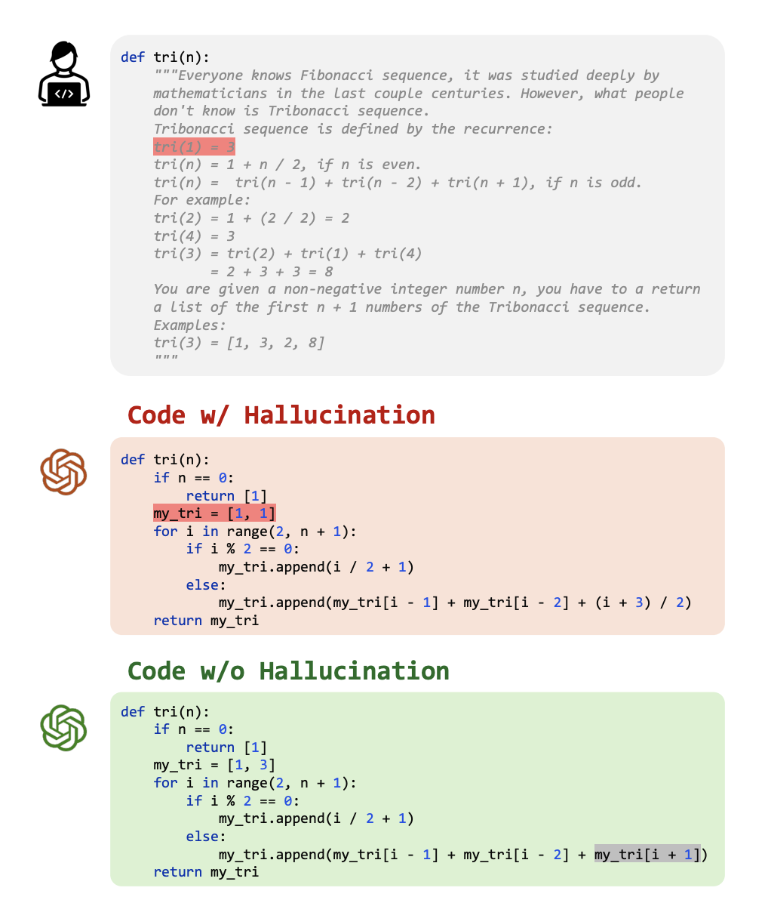
Illustration of code with and without hallucination
Key distinction:
- Not every hallucination is a bug
- Not every bug is a hallucination
BEYOND FUNCTIONAL CORRECTNESS
PAGE 4

Slide 5
THREE RESEARCH QUESTIONS
RQ1
WHAT hallucination types exist across models
RQ2
WHY they happen (model, prompt, task)
RQ3
HOW they break functionality, readability, maintainability
Distribution → Causes → Impact
BEYOND FUNCTIONAL CORRECTNESS
PAGE 5

Slide 6
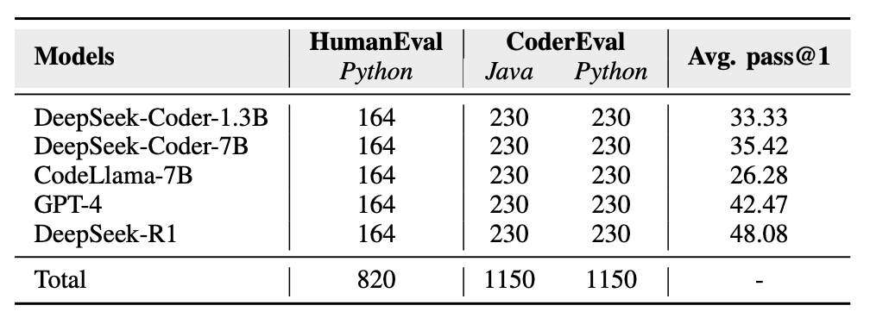
STUDY DESIGN
*reflect the 2024 state-of-the-art
5 LLMs × 2 Benchmarks = 3,120 samples → Thematic Analysis → Taxonomy
Greedy decoding (do_sample=False) — deterministic output. Same model + same prompt = same code every time.
BEYOND FUNCTIONAL CORRECTNESS
PAGE 6

Slide 7
MANUAL ANALYSIS
Input:
Determined:
What type of hallucination? Where?
- Task description (docstring)
- Generated code
Why did it happen?
- Reference solution
- Test execution results
What does it break?
Phase 1:
Phase 2:
10 annotators · 2,620 samples · ~240 hrs
→ Each sample: 2 independent annotators
2 experts · 500 samples · ~60 hrs
→ Codebook + initial taxonomy
Cohen's Kappa: 0.76 – 0.96 ✓ (threshold for substantial agreement: 0.6)
BEYOND FUNCTIONAL CORRECTNESS
PAGE 7

Slide 8
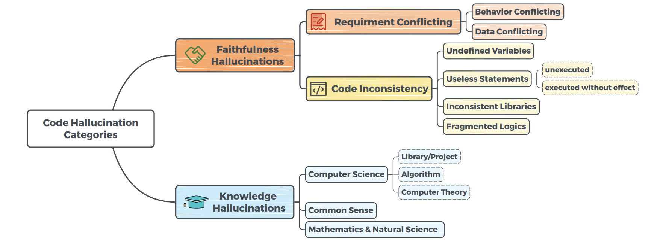
TAXONOMY OF CODE HALLUCINATIONS
3 categories · 12 types · 1,212 hallucinatory snippets found in 3,120 samples
39.6%
65.1%
25.5%
33.25%
34.9%
0.25%
1.40%
BEYOND FUNCTIONAL CORRECTNESS
PAGE 8

Slide 9
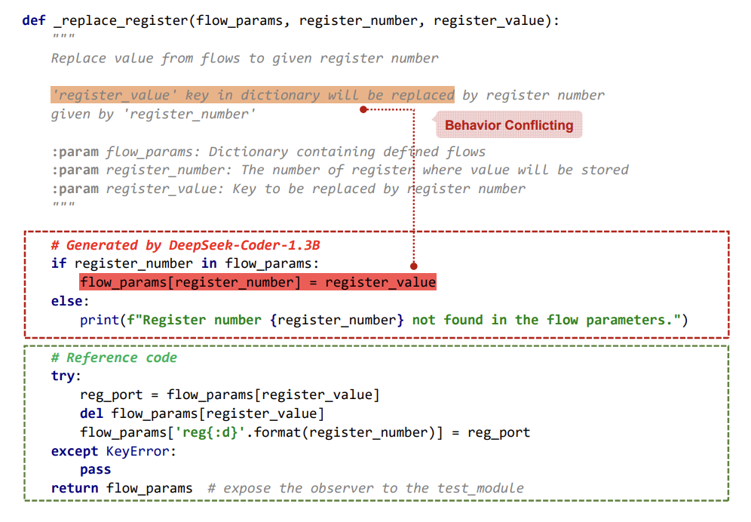
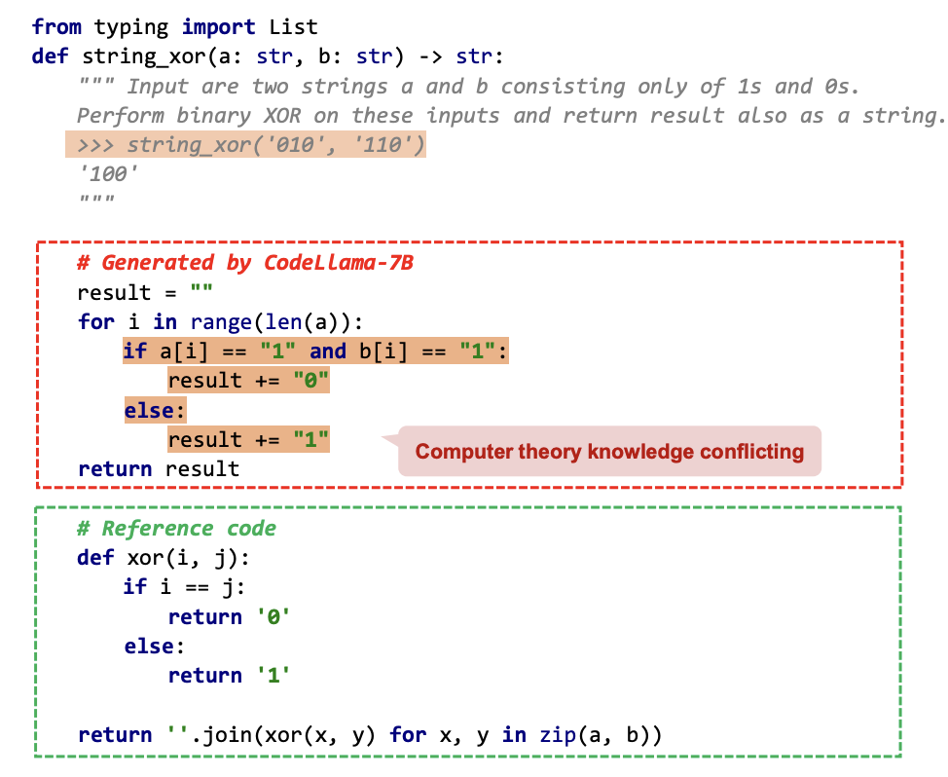
EXAMPLES
Behavior Conflicting (Req. Conflicting)
Computer Theory (Knowledge Hallucination)
BEYOND FUNCTIONAL CORRECTNESS
PAGE 9

Slide 10
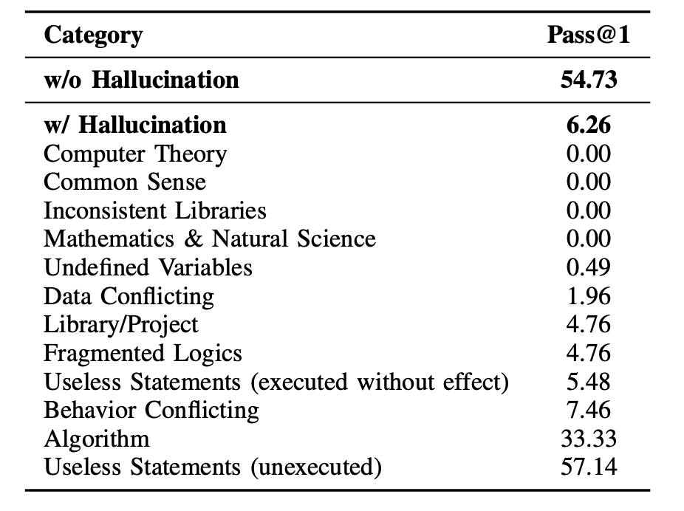

HALLUCINATION ≠ BUG
w/o Hallucination
54.37
w/ Hallucination
6.26
Useless Statements (unexecuted)
57.14
BEYOND FUNCTIONAL CORRECTNESS
PAGE 10

Slide 11
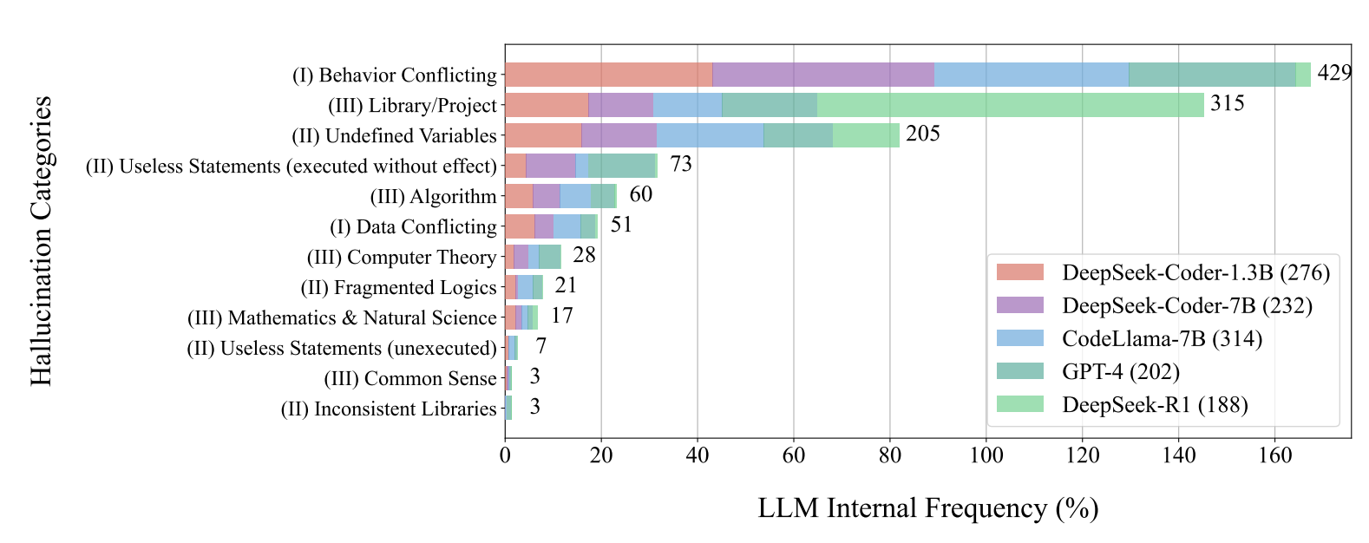
RQ1: DISTRIBUTION ACROSS MODELS
Behavior Conflicting
Library/Project
Undefined Variables
BEYOND FUNCTIONAL CORRECTNESS
PAGE 11

Slide 12
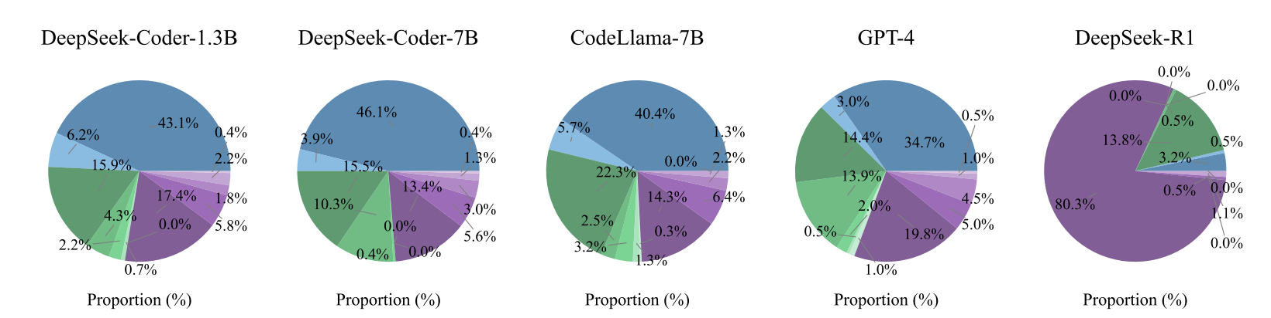
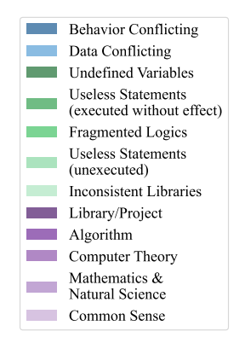
RQ1: DISTRIBUTION ACROSS MODELS
• Better reasoning → shifts problem, doesn't eliminate it
• Model size alone ≠ fewer hallucinations
• Training strategy matters as much as parameters
BEYOND FUNCTIONAL CORRECTNESS
PAGE 12

Slide 13
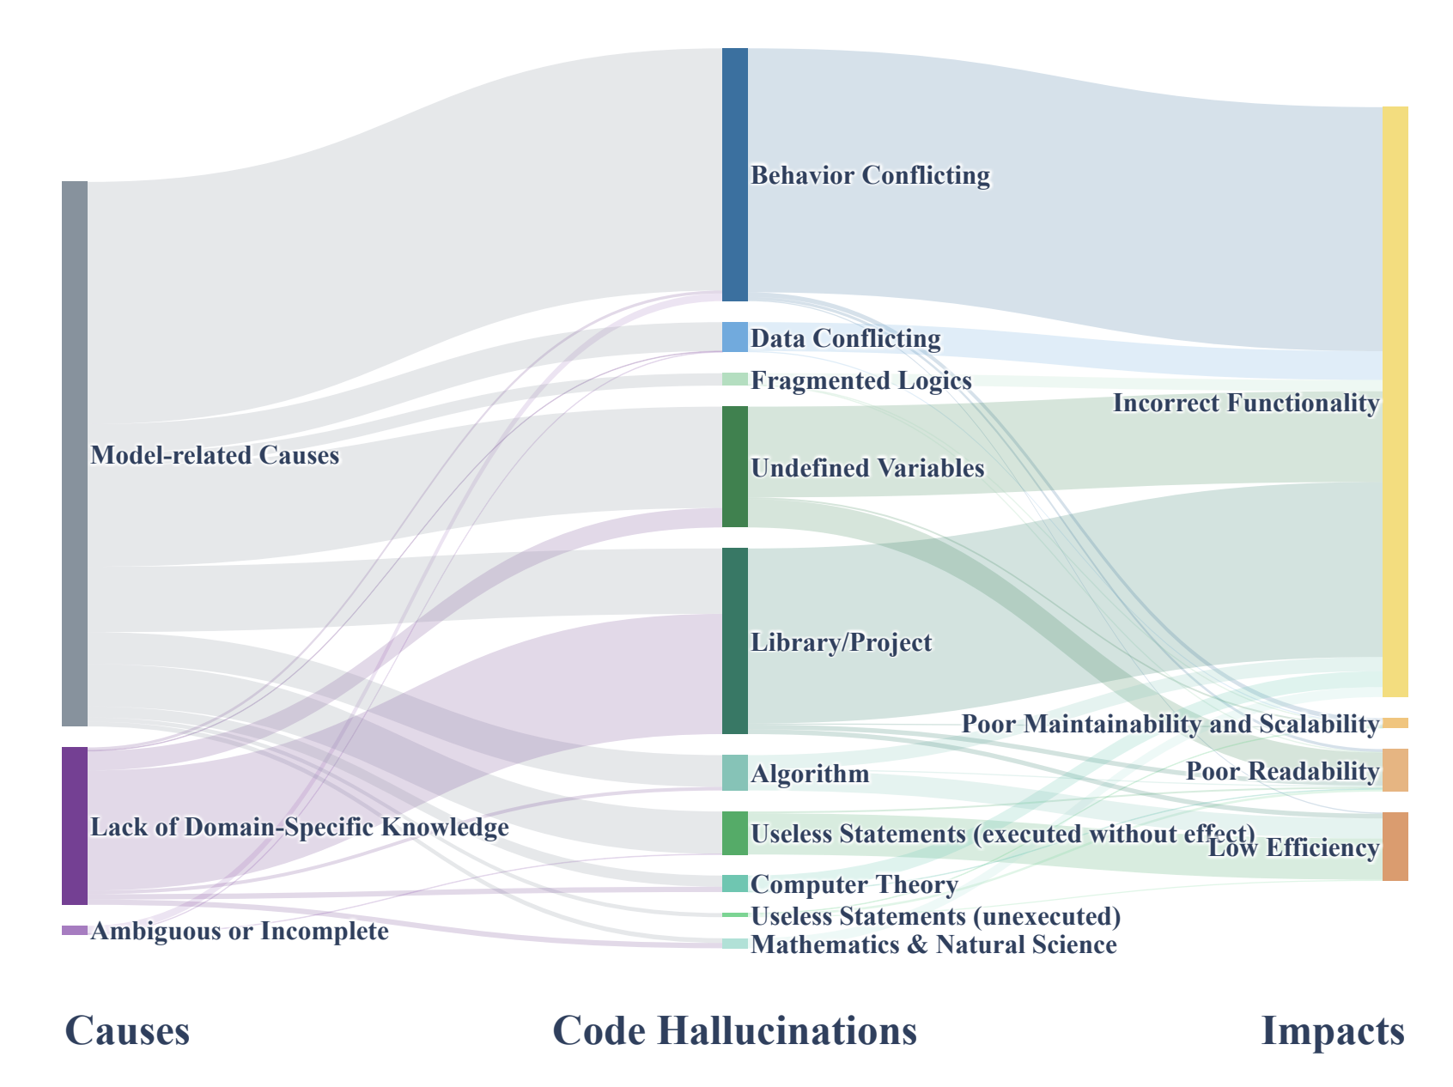
RQ2: WHY DO HALLUCINATIONS OCCUR?
training data, model size, architecture →
80.86%
26.24%
missing library, project, or API context →
unclear or incomplete task description →
1.90%
BEYOND FUNCTIONAL CORRECTNESS
PAGE 13

Slide 14
RQ3: HOW DO HALLUCINATIONS AFFECT CODE QUALITY?
Incorrect Functionality
95.30%
Poor Readability
14.27%
Low Efficiency
5.20%
Poor Maintainability
3.88%
Code errors vs hallucinations (3,120 samples):
 | With Error | No Error | Total
With Hallucination | 34.07% | 2.28% | 36.35%
No Hallucination | 28.81% | 34.84% | 63.65%
BEYOND FUNCTIONAL CORRECTNESS
PAGE 14

Slide 15
CAN WE FIX THIS WITHOUT RETRAINING?
Self-Refine
CoT
Target: Req. Conflicting
Target: Req. Conflicting
Ask model to explain requirements first
Ask model to reason step by step
pass@1: −7.32%
pass@1: −9.76%
RAG
Target: Knowledge
Retrieve relevant repo code into prompt
pass@1: +11.74%
* Self-Refine & CoT tested on 1.3B model -error propagation outweighs benefits on small models. Larger models handle multi-step reasoning better.
BEYOND FUNCTIONAL CORRECTNESS
PAGE 15

Slide 16
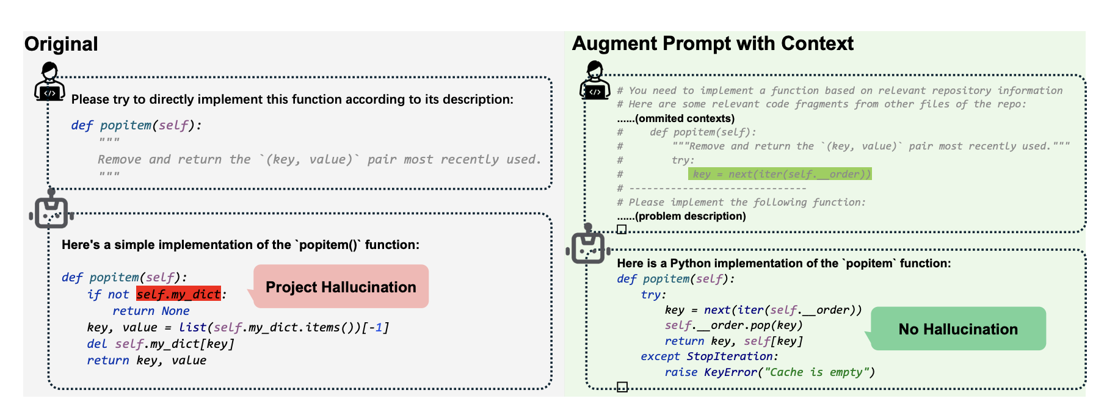
RAG for hallucination mitigation
BEYOND FUNCTIONAL CORRECTNESS
PAGE 16

Slide 17
KEY TAKEAWAYS
1
Code hallucinations ≠ bugs - a distinct taxonomy is needed
2
Behavior Conflicting dominates; reasoning ability shifts the pattern
3
Model capability is the primary cause (80.86%) - but prompt complexity also matters
4
RAG works best; CoT/Self-Refine need large models to avoid error propagation
5
pass@k misses hallucinations - new evaluation metrics are needed
BEYOND FUNCTIONAL CORRECTNESS
PAGE 17

Slide 18
QUESTIONS TO DISCUSS
Have you ever noticed a hallucination in AI-generated code? Which type do you encounter most?
2
Should hallucination detection be part of CI/CD?
3
Which hallucination type is hardest to catch in code review - and why?
4
Do you review AI-generated code differently than human-written code?
Q&A
5
Has a hallucination ever cost you significant debugging time?
BEYOND FUNCTIONAL CORRECTNESS
PAGE 18

Slide 19
RESOURCES
Liu et al. (2026) — arXiv:2404.00971v3 — https://arxiv.org/abs/2404.00971
Stack Overflow Developer Survey 2025 — https://survey.stackoverflow.co/2025/ai/
Veracode GenAI Code Security Report 2025 — https://www.veracode.com/genai-code-security-report
Second Talent AI Coding Statistics 2026 — https://www.secondtalent.com/resources/ai-coding-assistant-statistics/
BEYOND FUNCTIONAL CORRECTNESS
PAGE 19

